Slide 1
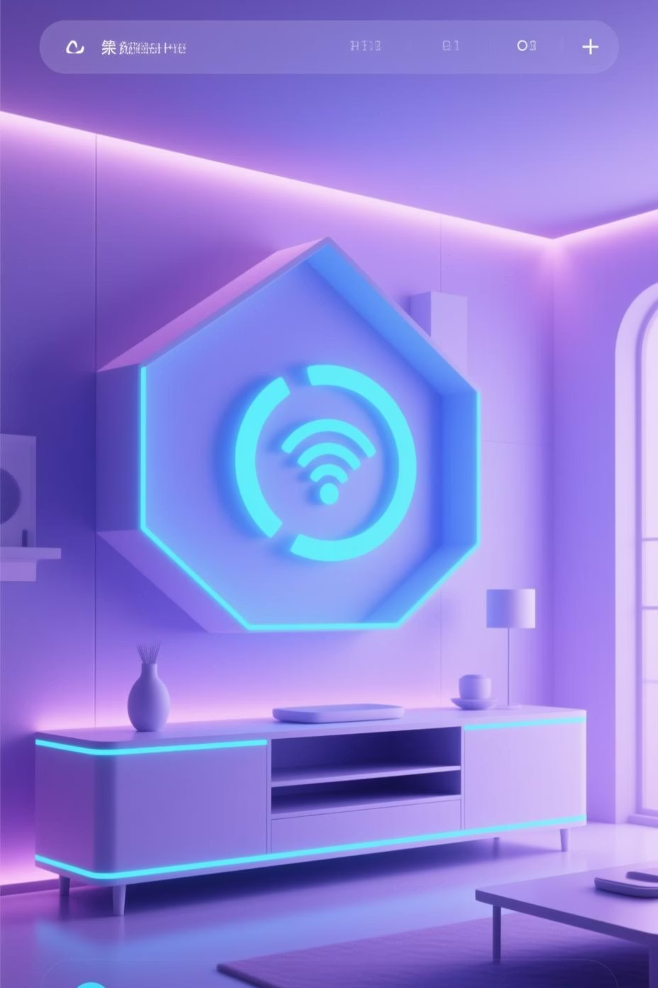
Smart Home IoT System
A full-stack IoT system integrating real hardware sensors with unified automation and control
Project Team: Muhammad Omais Rana, Muhammad Shiraz
December 17, 2025

Slide 2

Table of Contents
The Vision: Unified Home Automation
System Architecture
Multi-Protocol Network Stack
Sensor Data Collection
Node-RED Hardware Automations
Laravel Business Logic
Hybrid Data Strategy
Dual Dashboard System
Future Enhancements

Slide 3





The Vision: Unified Home Automation
Monitor
Surveil
Simulate
Track environmental conditions with Temperature & Humidity sensors
Live MJPEG video feed for premises security
Virtual Door Sensor using Digital Twin concept
Automate
Notify
Respond to environmental hazards with smart alerts
Email alerts for security breaches and events
Unlike proprietary systems, this open-source architecture provides a single interface to control your entire home ecosystem.
2

Slide 4
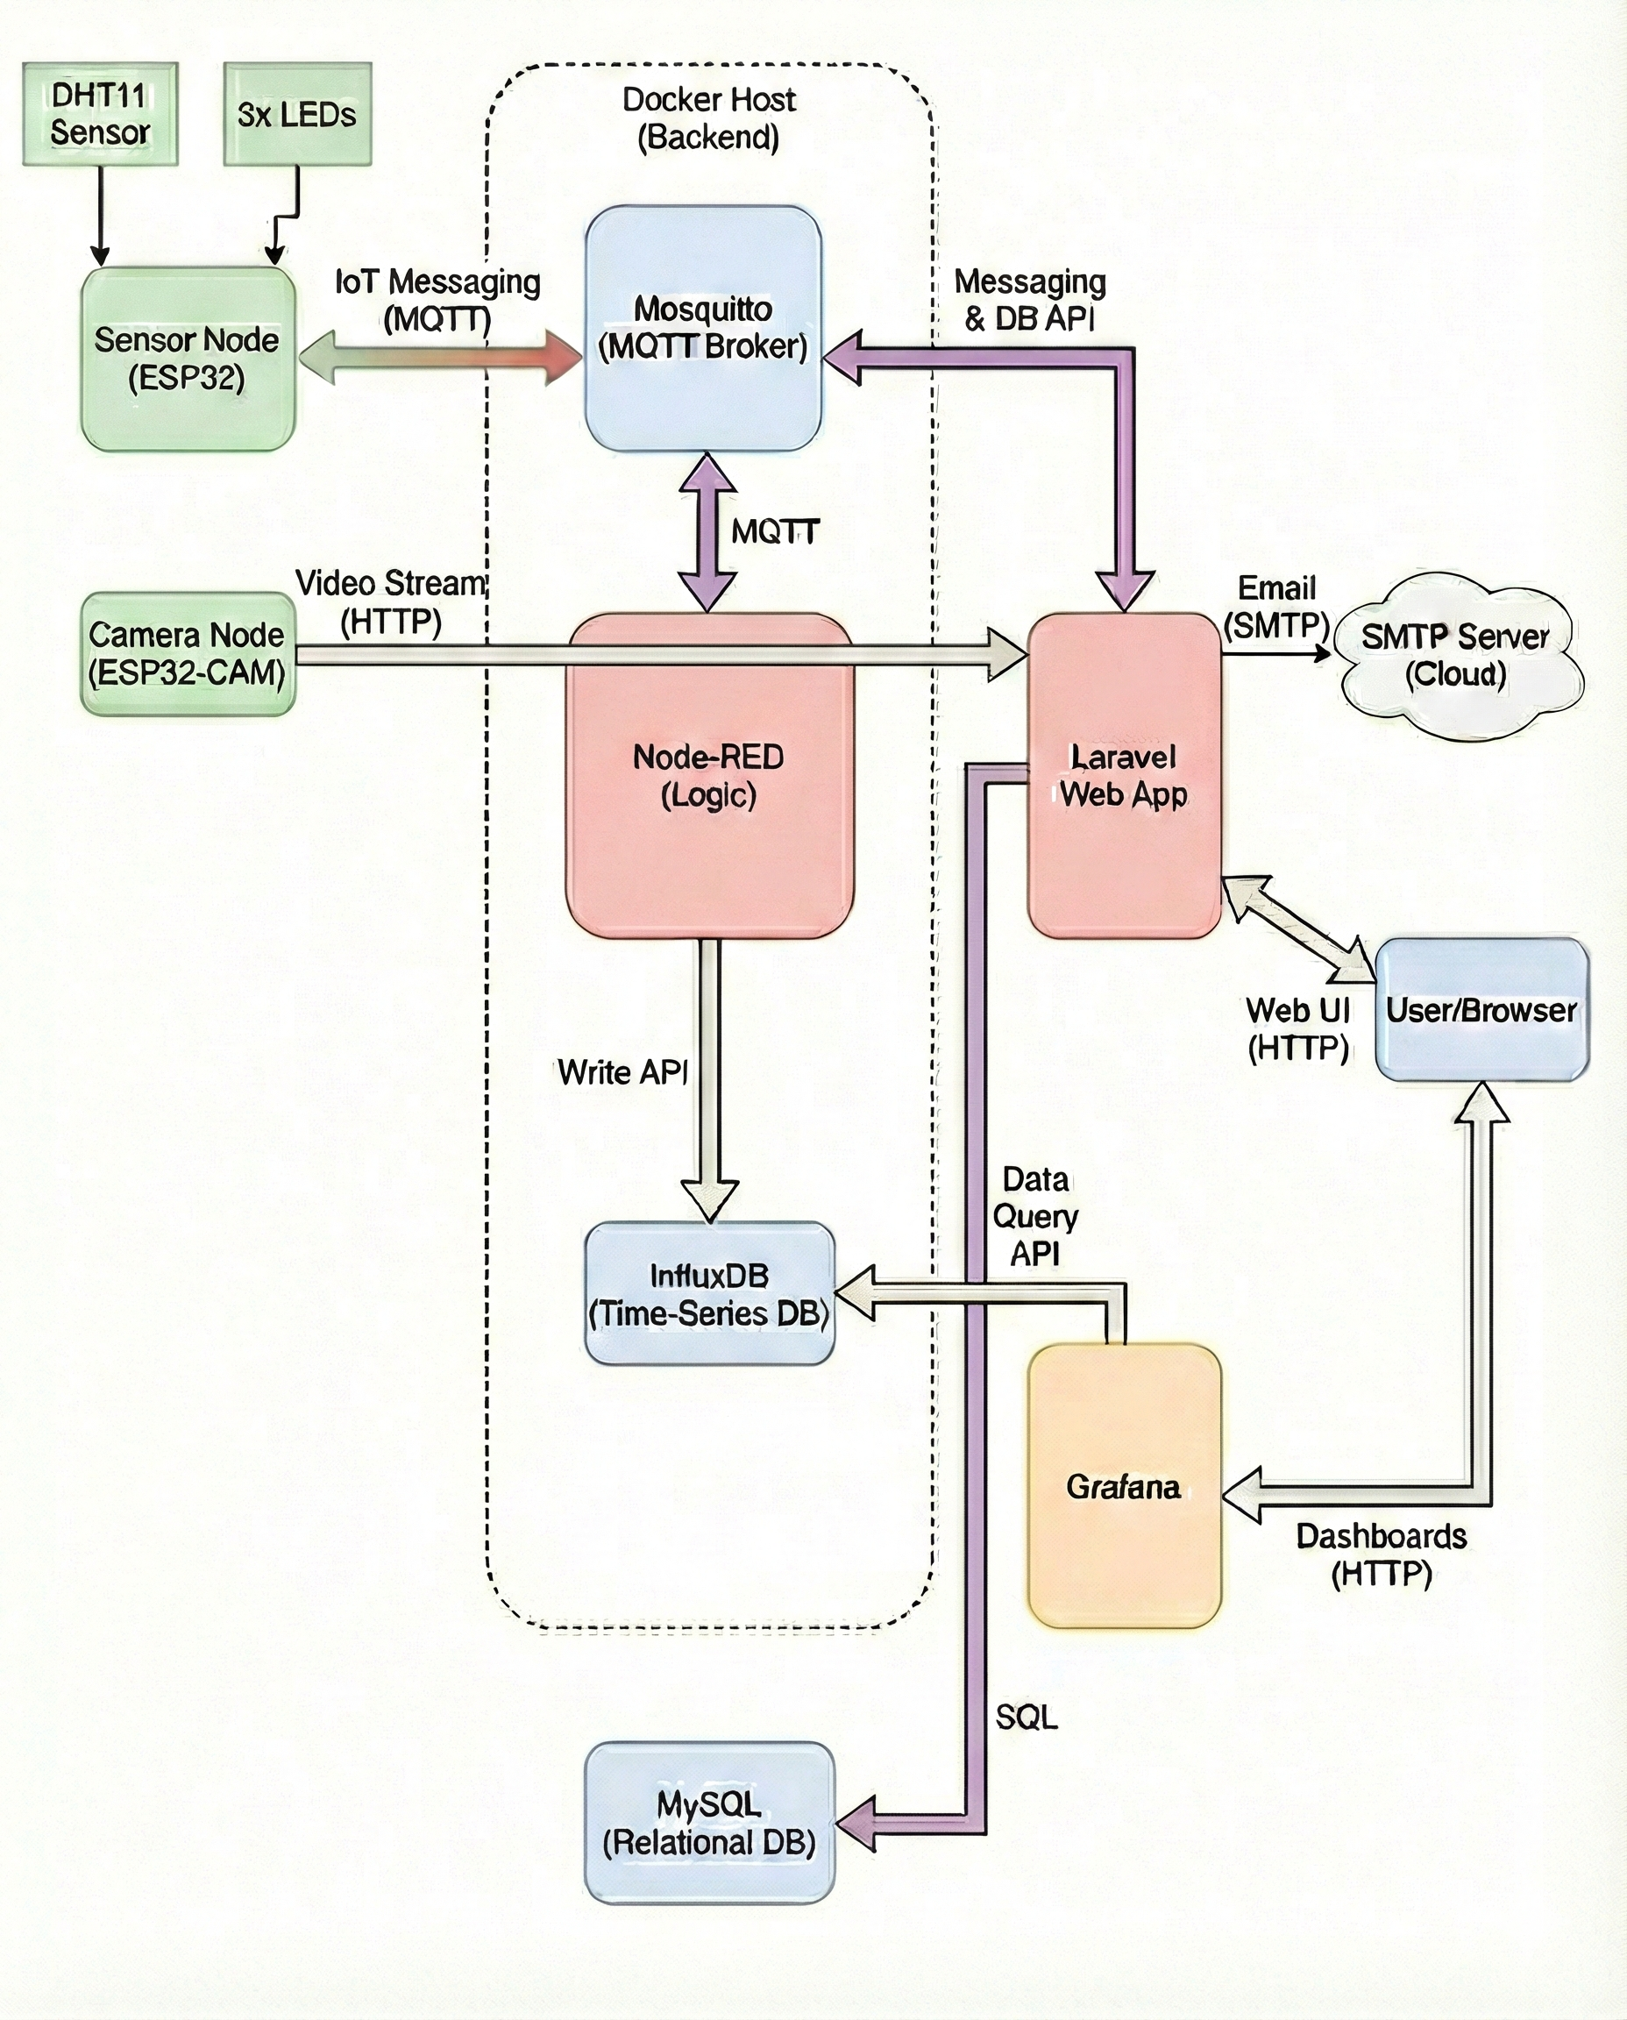
System Architecture
Hardware Layer
Processing Layer
Application Layer
ESP32 Sensor Node controls four actuators:
Node-RED: Hardware automation brain running parallel flows
Laravel: Primary control center and user interface
Main Light
InfluxDB: Time-series sensor storage
Grafana: Historical analytics and trend visualization
AC Indicator
Mold Alert
DHT11
MySQL: Relational device state management
ArduCAM Vision Node streams live MJPEG video
3

Slide 5
Multi-Protocol Network Stack
MQTT
HTTP
SMTP
TCP/IP Wi-Fi
Lightweight Publish/Subscribe model for real-time sensor data and control commands. ESP32 publishes telemetry and subscribes to command topics.
Handles media streaming (MJPEG video), database queries, and web dashboard delivery across the network.
Laravel connects to mail servers to dispatch security alert emails when door status changes are detected.
Provides the underlying transport layer connectivity for all devices on the smart home network.
4

Slide 6
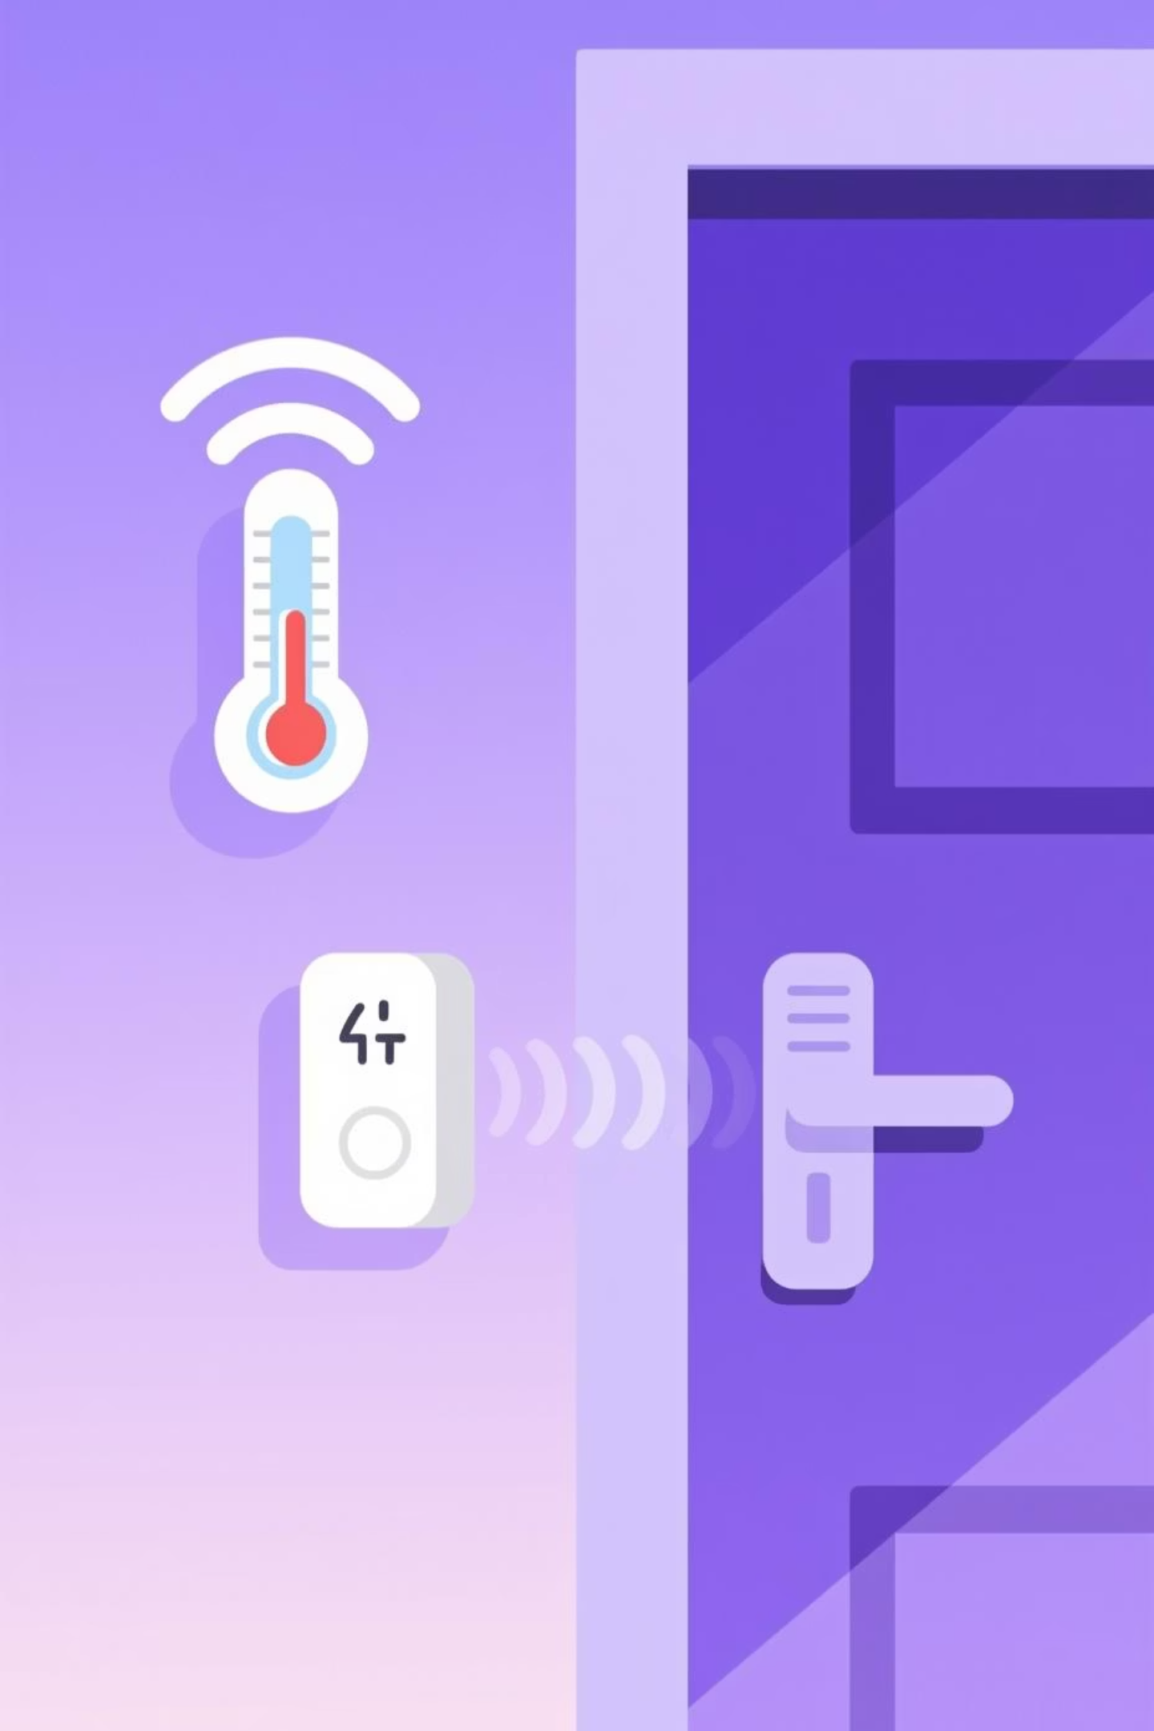
Sensor Data Collection
1
2
Temperature & Humidity
Visual Feed
Source: Real data from DHT11 sensor
Source: Real data from ArduCAM
Sampling Rate: Every 5 seconds
Format: MJPEG Stream over Wi-Fi
Purpose: Environmental monitoring and AC automation
Purpose: Live premises surveillance
3
Door Status
Source: Synthetic data via Dashboard Toggle
States: 0=Closed, 1=Open
Purpose: Security event simulation and notification testing
5

Slide 7

Hybrid Data Strategy
Real Physical Data
Synthetic Simulation
Temperature readings from DHT11 sensor
Door Sensor simulated via software toggle
Humidity measurements from DHT11 sensor
Tests Laravel SMTP notification pipeline
Video feeds from ArduCAM hardware
No physical magnetic reed switch required
Provides authentic environmental monitoring and surveillance capabilities
Enables testing of security workflows without additional hardware
6

Slide 8
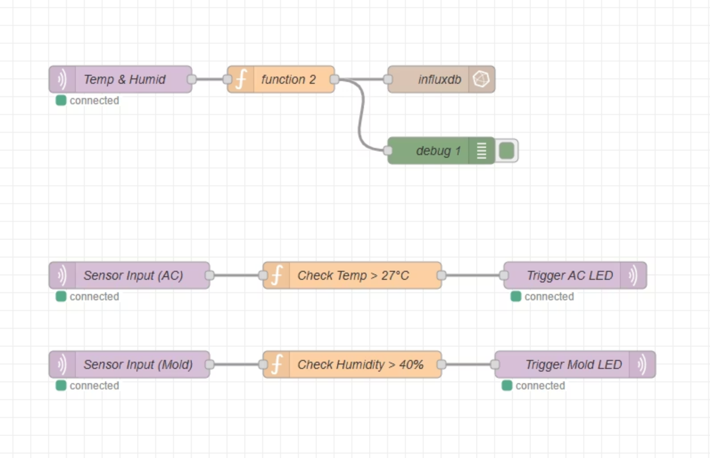
Node-RED Hardware Automations
Node-RED handles "fast" logic close to the hardware with three distinct automation flows:
1. Data Pipeline
2. Smart AC Control
3. Mold & Hazard Alert
Ingests raw JSON from MQTT and writes to InfluxDB for historical analysis.
Activates AC (Blue LED indicator) if temperature exceeds 27°C.
Activates Red LED warning if humidity exceeds 40%.
7
6

Slide 9

Laravel Business Logic
Security Notification System
Trigger: Listens for state changes in MySQL table (Virtual Door)
Action: When state changes to 1 (Open), Laravel queues a job to send email via SMTP to homeowner
Purpose: Event-driven alerting for security breaches
8

Slide 10
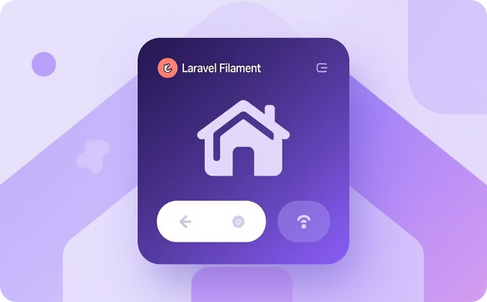
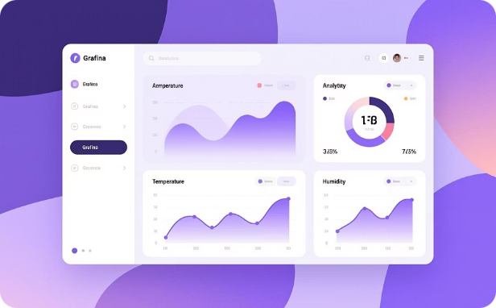
Dual Dashboard System
Operational Dashboard
Analytical Dashboard
Platform: Laravel
Platform: Grafana
Functions: Controls Main Light, monitors Door status, displays live Video feed
Functions: Visualizes historical Temperature and Humidity trends from InfluxDB
Purpose: Real-time device control and monitoring
Purpose: Long-term pattern analysis and insights
9

Slide 11
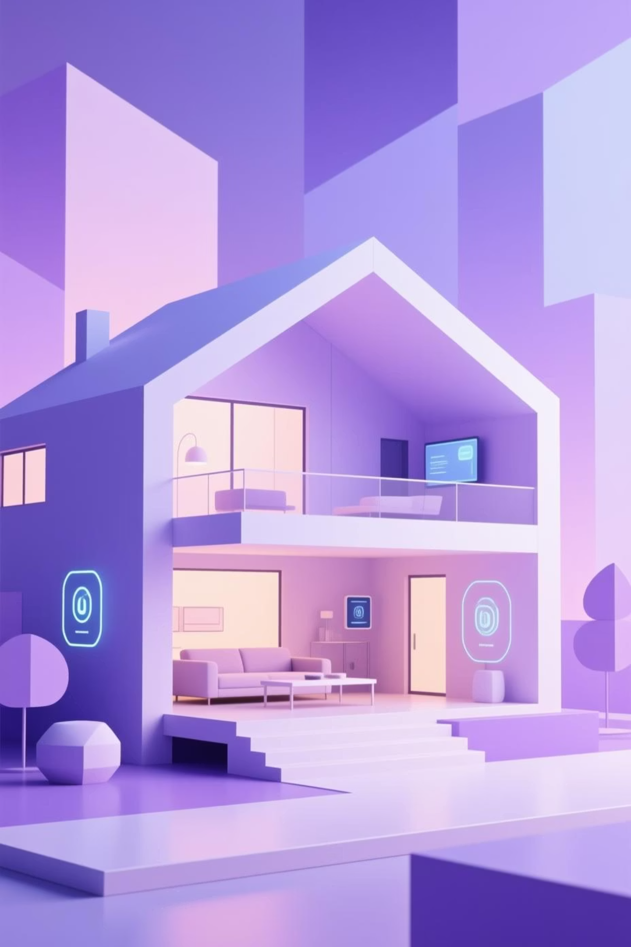



Future Enhancements
Predictive HVAC Control
Use Machine Learning on InfluxDB data to activate AC based on historical daily patterns rather than simple temperature thresholds
Computer Vision
Process camera feed to distinguish between authorized residents and intruders using facial recognition
Energy Optimization
Correlate "AC On" duration with temperature drops to calculate room insulation efficiency and reduce energy consumption
10

Slide 12
Demonstration
Showcasing what we have talked about.
GitHub Link
https://github.com/Omais-Rana/UMLP-M1-IoT/tree/main/LAS%20(IoT%20App%20Development)/smart-home-iot
10

